Slide 1
EE 261
ASYNCHRONOUS & DC MACHINES
by
Prof. Philip Yaw Okyere

Slide 2
Armature Windings
Armature windings are the windings of a rotating machine in which motional emfs are induced.
These emfs give rise to mechanical/ electrical energy conversion.
The armature windings consist of coils connected in series or series-parallel circuits.
The coils are properly placed so that their individual emfs can be effectively collected

Slide 3
Armature Windings
In this chapter we look at how conductors are placed in rotating machines,
how they are interconnected to obtain coils and
how the coils are interconnected to give armature windings for effective collection of the emfs induced in the conductors.
The expression for the total emf induced in the armature winding is also derived.

Slide 4
Armature-conductor connection
Two conductors and connected back to back form a single-turn coil.
The two sides of the coils are spaced in such a way that when one of its sides is under the influence of a north pole say, its other side is under the influence of a south pole for most of this time.
Multi-turn coils consist of 4 or more conductors.

Slide 5
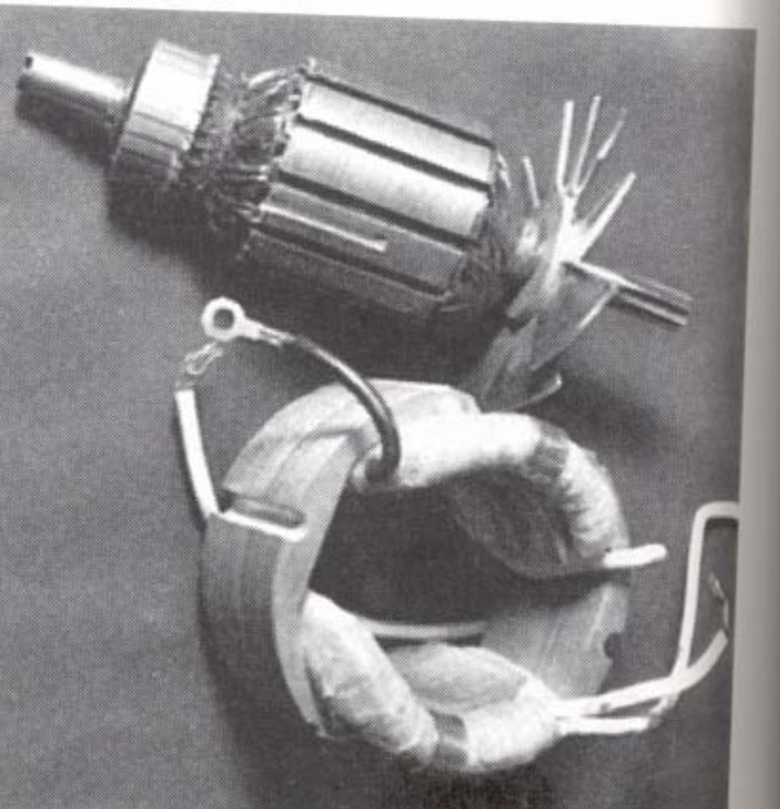

Slide 6
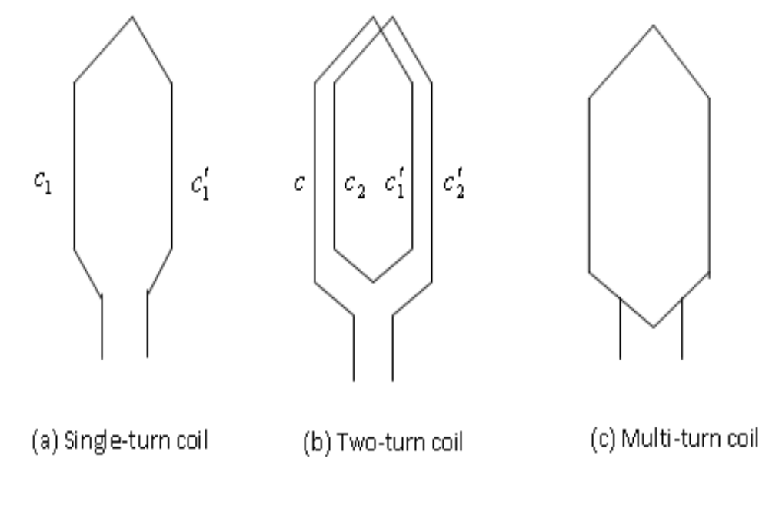
Armature-conductor connection

Slide 7
Slots
They are punched uniformly round the gap surface of the armature (i.e. that fixed or rotating member of the machine that carries the armature winding).
Coils are placed in the slots.
The slots may be open, semi-closed or closed.
Slots provide mechanical support for the conductors.

Slide 8
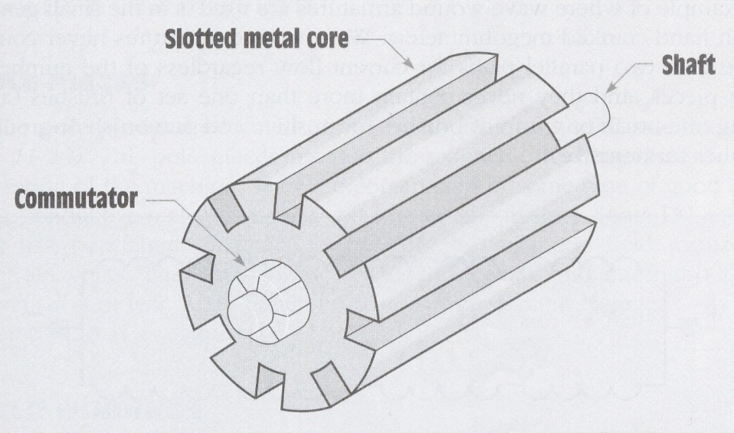
Slots

Slide 9
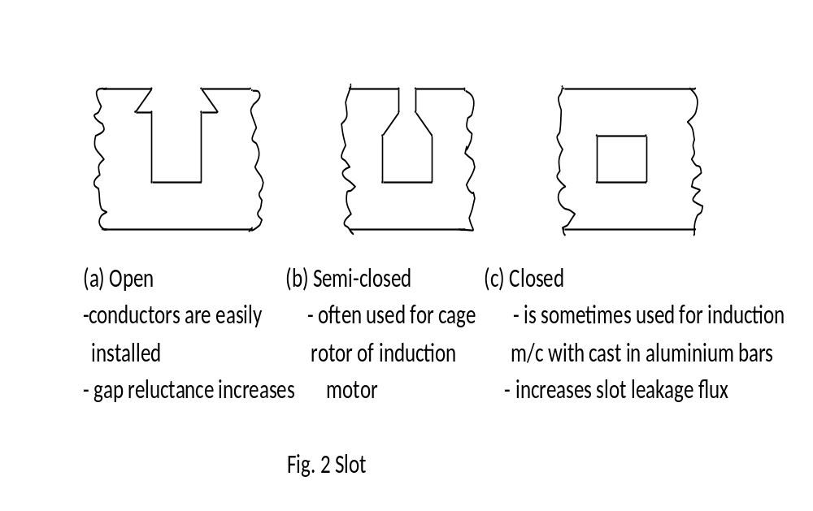
Slots

Slide 10
Single-layer and two-(or double-)layer windings
The way slots are filled with the sides of coils gives two basic types of armature windings:

Slide 11

Single-layer winding:
In this winding each side of one coil occupies a whole slot.
The coils contain many insulated turns.
Single-layer coils have the advantage that semi-closed or closed slots can be easily used.

Slide 12
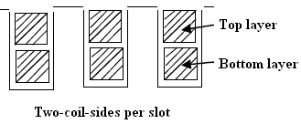
Two-layer winding
  Here one side of a coil lies in the top half of a slot and the other side in the bottom half of another slot a pole-pitch or less away.
  All coils are identical.
  Open slots are frequently used.

Slide 13
Lap and wave winding
The front-end of a two-layer coil can be bent inward or outward to bring about the connection from one coil to another.
Inward gives what is called a lap winding and
Outward gives what is called a wave winding

Slide 14
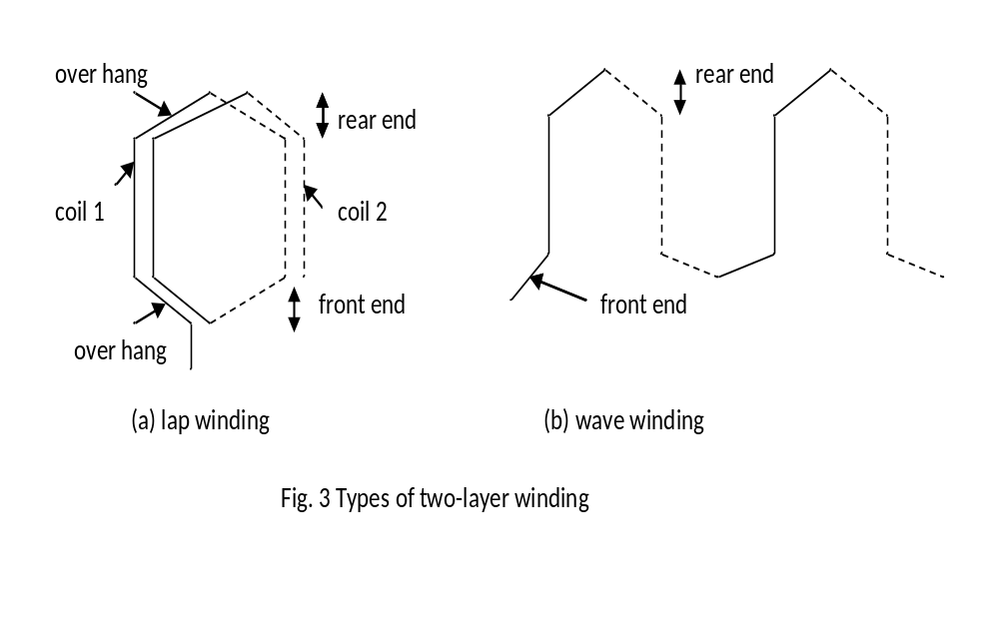
Lap and wave winding

Slide 15
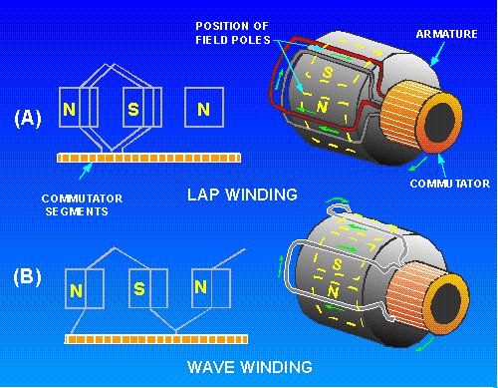

Slide 16
Common winding terms and symbols
  Pole-pitch: the distance between the centres of adjacent poles. It is 180 electrical degrees. The symbol is τ.
  Conductor: the active length of wire or strip (bar) in the slot. Z = total number of conductors in a winding.

Slide 17
  Coil: single-turn coil consists of two conductors separated by a pole-pitch or nearly so connected back to back. In multi-turn coil, many conductors occupying virtually the same magnetic position are included before the ends of the coils are brought out. C = total number of coils.
  Coil side: one half of a coil lying in one slot.

Slide 18
  Back pitch or coil pitch (or coil span):
  it is the span of a coil. It is measured in coil sides, sometimes as a fraction of the full pole-pitch or in electrical degrees.
  The symbol is y_{b}. If y_{b} = 180 degrees the coil is called “full-pitch” coil. If y_{b} is less than 180 degrees, the coil is called “fractional pitch” coil or a “chorded” coil.
  Fractional-pitch coils use slightly less copper than full-pitch coils, and they also improve commutation.

Slide 19
Commutator windings
The commutator:
  It consists of many copper segments which run parallel to one another.
  The copper segments are insulated from one another (mica is used).
  They are clamped around the surface of an insulated cylinder.

Slide 20
  To each commutator bar or segment is connected a coil junction (i.e. where a coil is joined to another). Hence the number of bars = the number of coils in the winding.
  The commutator enables us to obtain a steady and direct voltage from alternating emf generated in the armature conductor.

Slide 21
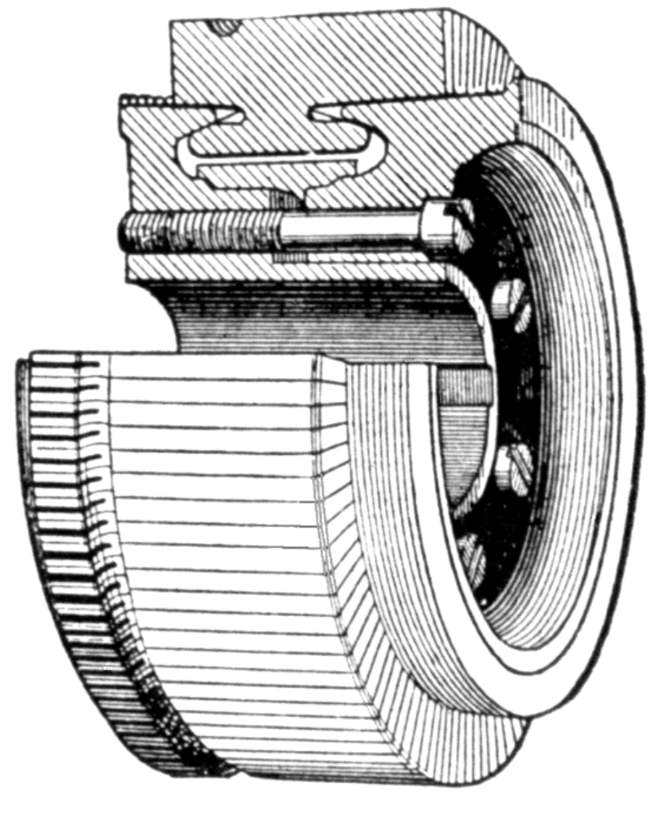
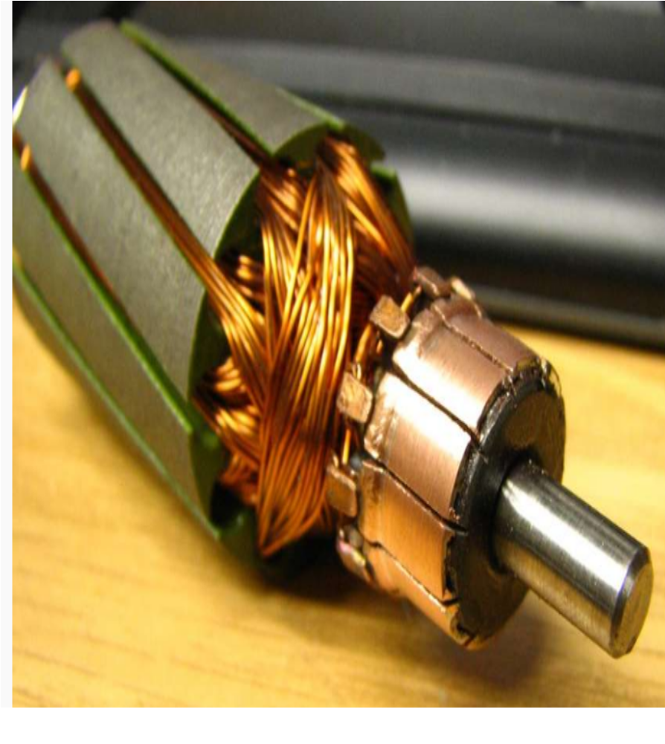

Slide 22
Type of layer or winding: two-layer coils are employed.
Slot :
  Small size machines , 7.46 kW or less, use semi-enclosed slots.
  The coils are wound directly into the slots either manually or by machine

Slide 23
  Larger size machines use open slots and form-wound armature coils.
  DC motors operating under low-speed conditions quite often have the slots skewed, usually by one slot pitch, to prevent torque pulsations.
  It also reduces noise.

Slide 24
Slot arrangement: we note that
  the number of coils per slot = coil sides per layer (u).
  from the definition, C =Su
  u =1 is rarely used. u = 2, 3, 4 or even more coil sides/layer are used.

Slide 25
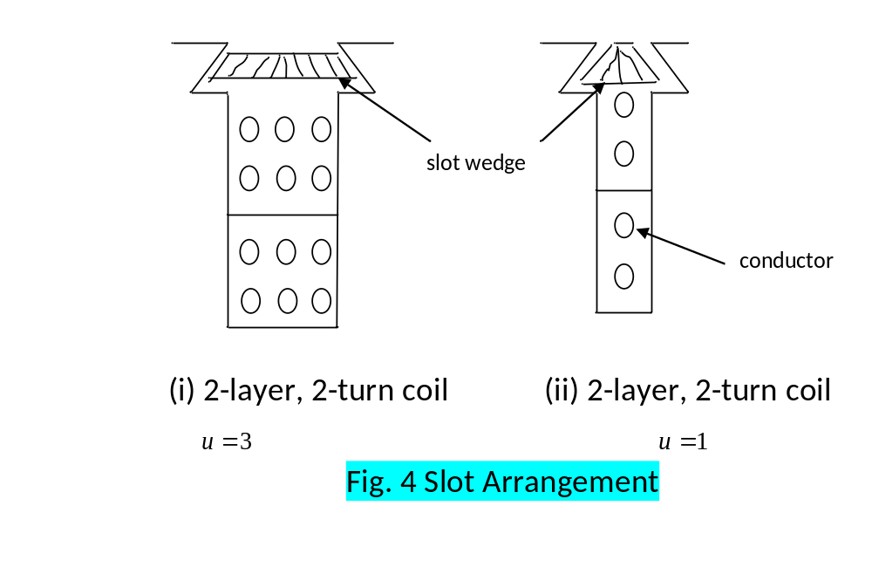
Slot arrangement:

Slide 26
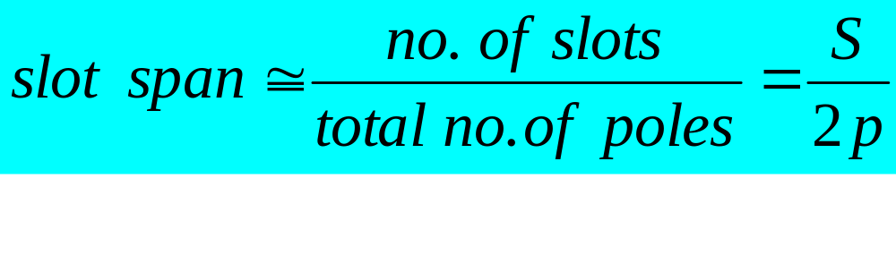
  Other terms used in commutator winding:
Slot span:
It is also used to indicate the span of a coil.
Measured in slots, it is given by the number of slots or teeth embraced by the coils.

Slide 27
If quotient is integer, then choosing this number for a coil span, a normal full-pitch winding is obtained
But for special cases, slot span can be taken one slot less to obtain slightly chorded winding.
If quotient is not an integer, then the nearest integer lower than S/2p is taken.
In actual machine slot span lies between 10 and 15 and it is slightly less than S/2p.

Slide 28
Coil-end pitch or commutator pitch
it is the distance between the end connections of a coil.
it is measured in commutator segments or bars between the two legs of the coil.

Slide 29
Progressive or retrogressive winding:
In progressive winding, winding progresses in the direction in which the coils are wound
whereas in retrogressive winding, winding progresses in the opposite direction.

Slide 30
